Slide 1
Microservices and DevOps
Scalable Microservices
Scalable Storage through Sharding
Henrik Bærbak Christensen

Slide 2
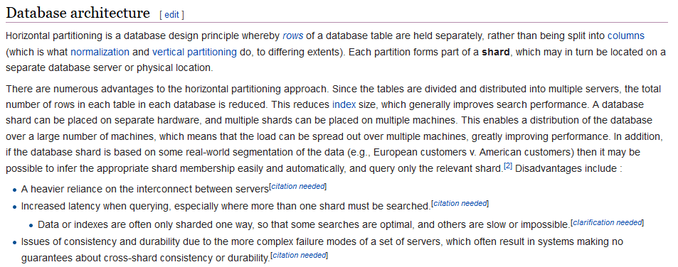
Wikipedia

Slide 3
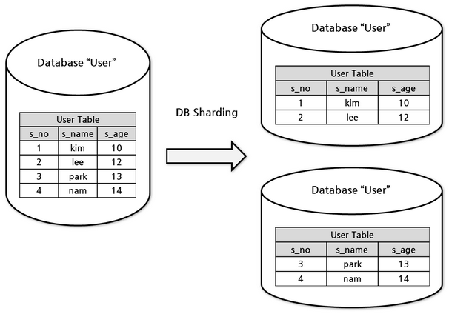
So…

Slide 4
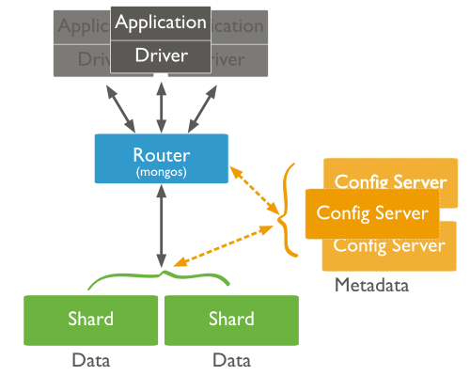
MongoDB Sharding
Shard Key
  Doc field, determine
  which shard the
  doc will reside on
Production
  Each shard =
  a replica set!

Slide 5
Redis Sharding
Is part of the Clustering mechanism…
So – we have already been there…

Slide 6

Sharding
Every key is part of a hash slot
  Redis has exactly 16384 hash slots
    Every key is mapped to one of these hash slots
Every node (master) is responsible for a subset, e.g.
If we add two more nodes (masters), we just move the relevant hash slots to the new masters…
  Uhum, transactions need to cover only keys in the same slot ☹
    So there is a mechanism to guaranty that… anyway…

